Slide 1
Poba Medical Capstone
Concept Generation
Michael Bransky, Noah Keyes, Vergil Sorg

Slide 2

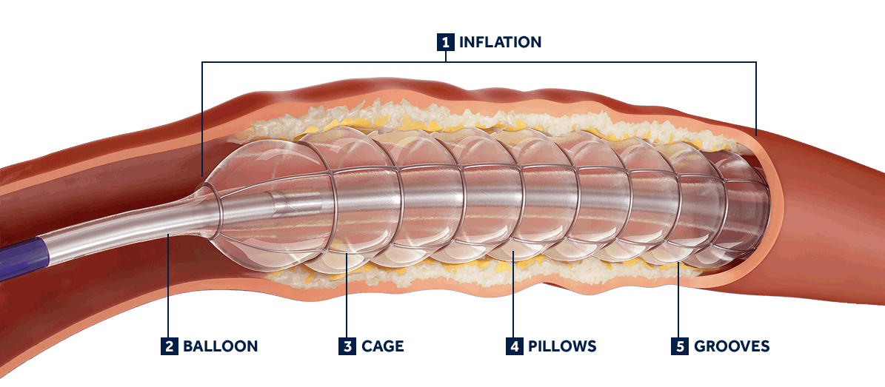
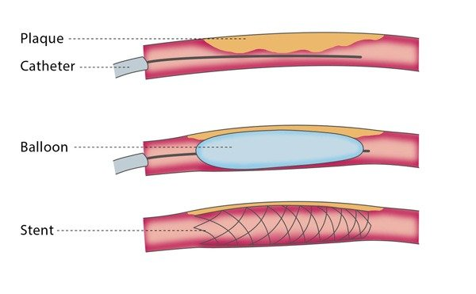
Project Description
Poba Medical wants our team to design and build a radial expansion tester, with controlled temperature and axial load, for the extruded plastic tubes used in the manufacture of their balloon catheters.

Slide 3
Black Box Model
Plastic Extrusion, Compressed Nitrogen, Hand
Black Box
Popped balloon, hand
Human, Electric
Sound, thermal
Dia. measurement, temp. measurement, axial load measurement, pressure measurement
On/Off

Slide 4
Concept Generation
Sub-functions were created based off project description and meetings with engineers at Poba Medical
Concepts were generated through meetings with engineers at POBA Medical
Team examined machines at Poba Medical to see what was already being done
Team also created a discord to put ideas for each of the subsystems in
Team created morphological matrix in order to organize concept variants for ease of design

Slide 5
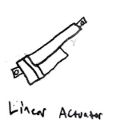
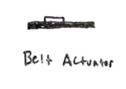
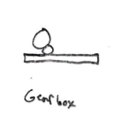
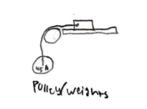

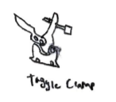
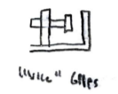
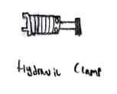
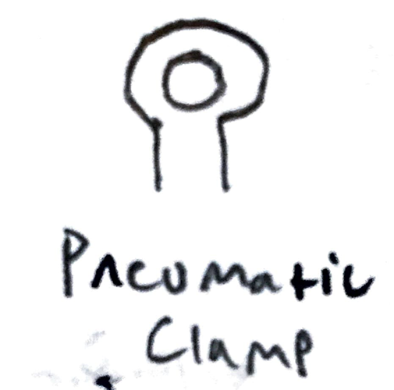
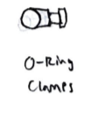
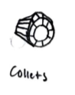
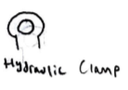
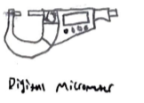
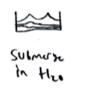


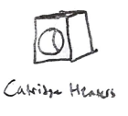

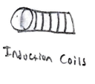
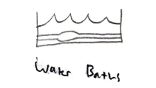
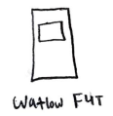
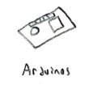

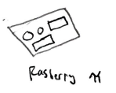
Subfunction | CV 1 | CV 2 | CV 3 | CV 4
Axial Load
Clamp
Clamp & Pressurize
Measure Diameter
Control Temperature
Take Measurements

Slide 6
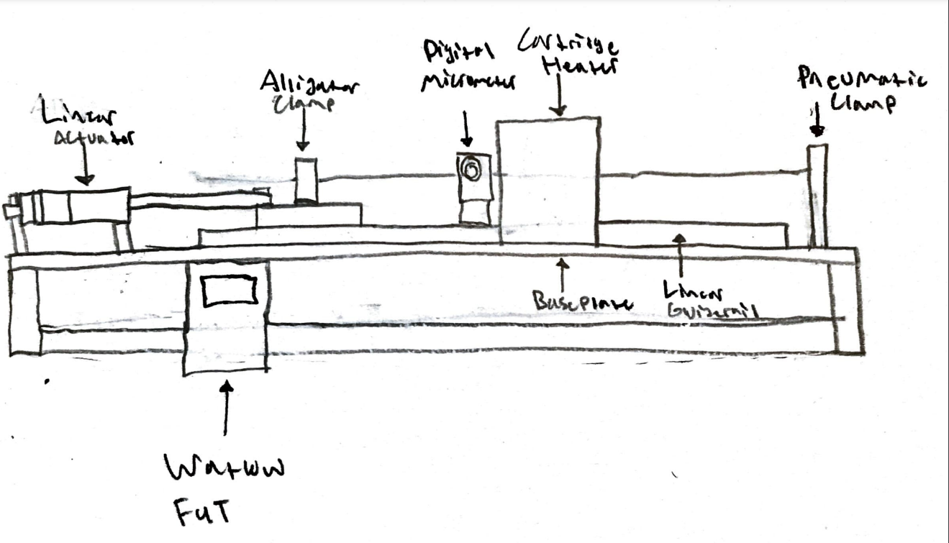
Concept Generation
Best Design:

Slide 7
Concept Generation
Design 1:
Design 2:
Pros:
Professional
Uses known technology
Easier assembly
Less total iterations
Cons:
Expensive
Radial measurement
Learning block coding
Circuitry
Pros:
Easier motor control
Cheap
Avoids cartridge heaters
Measurements are more controllable
Cons:
Harder assembly
Temperature control
Arduinos
Radial measurement
Circuitry

Slide 8
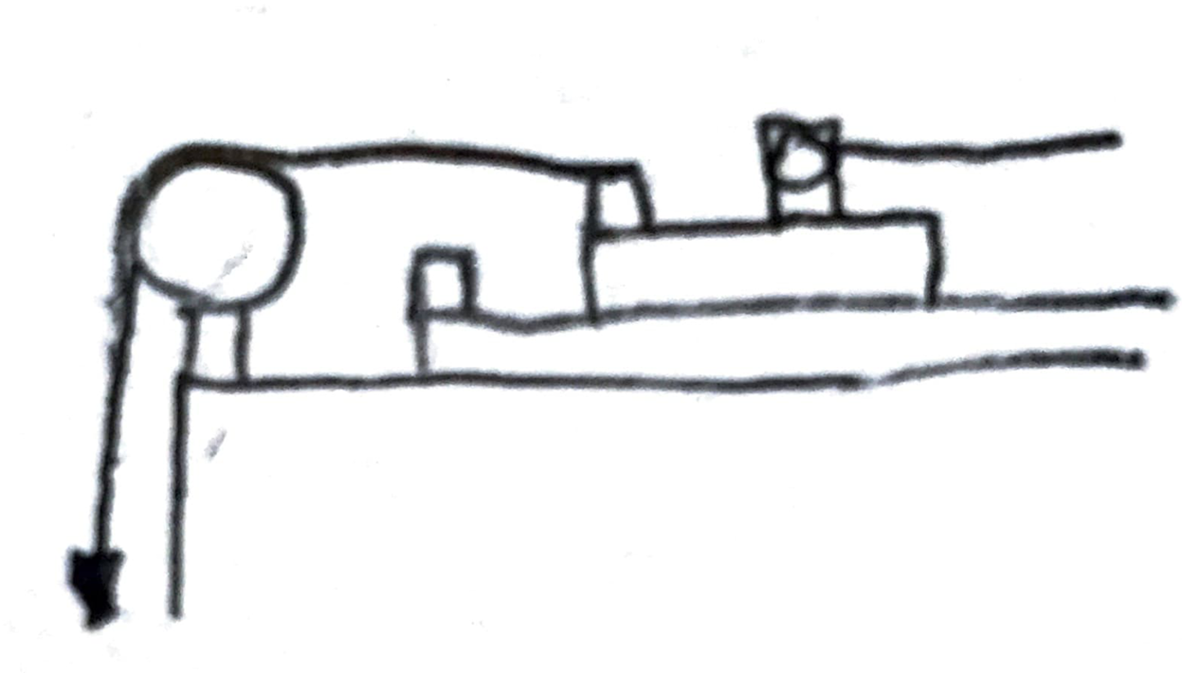
Concept Generation
Design 3:
Pros:
Cheap
Original design
Combine temperature and radial measurement
Cons:
Unprofessional
Not enough axial force precision
Have to design hydraulic systems
Possible catastrophic failure

Slide 9
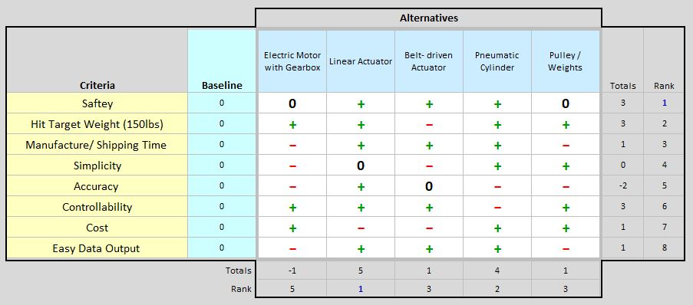
Concept Evaluation: Pugh Chart for Axial Load System

Slide 10
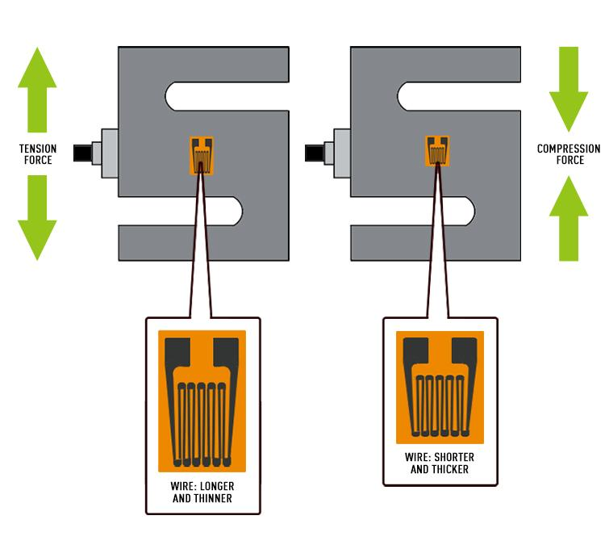
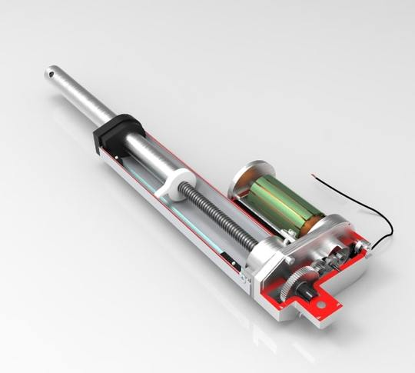
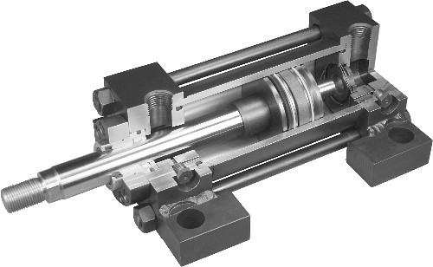
Linear Actuators vs Pneumatic Cylinders
Linear actuators
Controlled electronically: More PLC coding required
Need load cell for force measurement
More expensive $100-$500
More moving parts
Controllable with arduino
“Fixed” in place once actuated
Pneumatic Cylinders
Controlled pneumatically: need additional solenoid valve
Need load cell for force measurement
Cheap $20-$150
Very few parts
Air supply would need to be separate from extrusion pressurizing

Slide 11
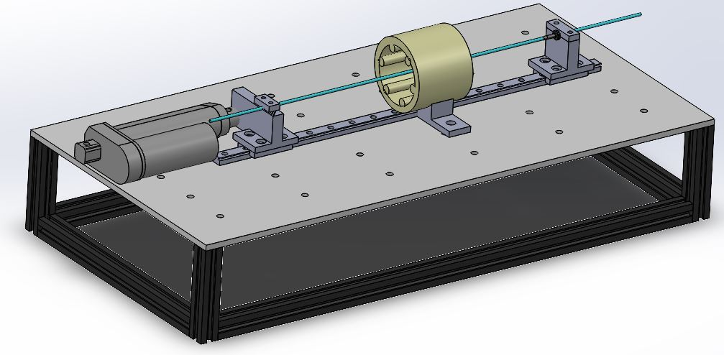
Prototype CAD Model
Built off of aluminum baseplate
Linear actuator provides axial force
T Slot extrusions to house electrical components
Linear guardrail will provide a movable base
Serrated jaws to clamp and hold closed end of extrusion
To start, we will test pressure and axial actuation with adjustable luer lock tube clamps and handheld pressure device
Expected use of cartridge heaters arranged radially

Slide 12
Engineering Requirements
Apply axial force up to 150lb - “Firgelli” linear actuator: 150lb dynamic, 300lb static vs Pneumatic cylinder
Ability to pressurize extrusions - Handheld for prototype, regulator for pressure
Heat extrusions up to 250F - Assortment of cartridge heaters with thermocouples vs Silicone Heaters
Continuous diameter measurement - Optical micrometer for contactless measurement vs drop indicator
Ability to output data/ control system - Watlow f4t PLC vs Arduino

Slide 13
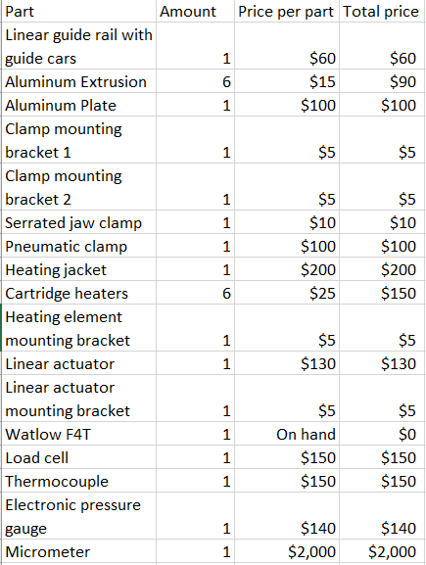
BOM
Total price comes out to $3,300
The largest expense is the micrometer

Slide 14
Budget Planning
The final product would cost us $3,300 to manufacture, which leaves $1,700 of our original budget
We plan to spend about $1,300 on prototyping
  $400 on the pulling subsystem
  $400 on the diameter measurement subsystem
  $500 on the heating subsystem
This leaves us with an extra $400 left over for contingencies
It is likely that we will have even more left over than estimated due to parts used for prototyping being reused in the final product

